Slide 1
Physical Security

Slide 2
Agenda
Introduction
Physical Access Controls
Failure of Supporting Utilities and Structural Collapse
Interception of Data
Mobile and Portable Systems

Slide 3
Introduction
Seven Major Sources of Physical Loss (Donn B. Parker)
Extreme temperature: heat, cold
Gases: war gases, commercial vapors, humid or dry air,
Liquids: water, chemicals
Living organisms: viruses, bacteria, people, animals, insects
Projectiles: tangible objects in motion, powered objects
Movement: collapse, shearing, shaking, vibration, liquefaction
Energy anomalies: electrical surge or failure, magnetism, static electricity, aging circuitry; radiation: sound, light, radio

Slide 4
Physical Access Controls
Secure facility: physical location engineered with controls designed to minimize risk of attacks from physical threats
Secure facility can take advantage of natural terrain, traffic flow, and degree of urban development; can complement these with protection mechanisms (fences, gates, walls, guards, alarms)

Slide 5
Physical Security Controls
Walls, Fencing, and Gates – walls and fences with suitably constructed gates are an essential starting point for organizations whose employees require access to the real estate the organization owns or controls
Guards – Guards can evaluate each situation as it arises and make reasoned responses. Most guards have clear standard operating procedures (SOPs) that help them to act decisively in unfamiliar situations
Dogs – Guard dogs are useful because their keen sense of smell and hearing can detect intrusions that human guards cannot

Slide 6
Physical Security Controls
ID cards and badges
Ties physical security with information access control
ID card is typically concealed
Name badge is visible
Serve as simple form of biometrics (facial recognition).
Should not be only means of control as cards can be easily duplicated, stolen, and modified.
Tailgating occurs when unauthorized individual follows authorized user through the control

Slide 7
Physical Security Controls
Locks and keys
Two types of locks: mechanical and electromechanical.
Locks can also be divided into four categories: manual, programmable, electronic, biometric
Locks fail and alternative procedures for controlling access must be put in place
Locks fail in one of two ways:
Fail-safe lock; the door lock fails and the door remained unlock
Fail-secure lock; the door lock fails and the door remains locked

Slide 8
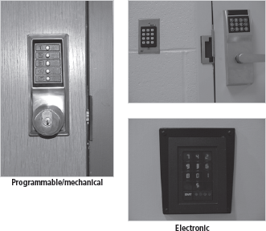
Physical Security Controls
Figure 9-1 Locks

Slide 9
Physical Security Controls
Mantraps
Small enclosure that has entry point and different exit point
Individual enters mantrap, requests access, and if verified, is allowed to exit mantrap into facility
Individual denied entry is not allowed to exit until security official overrides automatic locks of the enclosure

Slide 10
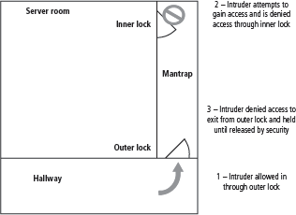
Physical Security Controls
Figure 9-2 Mantraps

Slide 11
Physical Security Controls
Electronic monitoring
Records events where other types of physical controls are impractical or incomplete
May use cameras with video recorders; includes closed-circuit television (CCT) systems
Drawbacks:
Reactive; does not prevent access or prohibited activity
Recordings often are not monitored in real time; must be reviewed to have any value

Slide 12
Physical Security Controls
Alarms and alarm systems
Alarm systems notify when an event occurs
Detect fire, intrusion, environmental disturbance, or an interruption in services.
Rely on sensors that detect event; e.g., motion detectors, smoke detectors, thermal detectors, glass breakage detectors, weight sensors, contact sensors, vibration sensors.

Slide 13
Failure of Supporting Utilities and Structural Collapse
Supporting utilities (heating, ventilation, and air conditioning; power; water; and others) have significant impact on continued safe operation of a facility
Each utility must be properly managed to prevent potential damage to information and information systems
Areas within heating, ventilation, and air conditioning (HVAC) systems that can cause damage to information systems include temperature, filtration, humidity, and static electricity

Slide 14
Maintenance of Facility Systems
Physical security must be constantly documented, evaluated, and tested
Documentation of facility’s configuration, operation, and function should be integrated into disaster recovery plans and operating procedures
Testing helps improve the facility’s physical security and identify weak points

Slide 15
Mobile and Portable Systems
Many mobile computing systems (e.g. laptops and handhelds) have corporate information stored within them; some are configured to facilitate user’s access into organization’s secure computing facilities (i.e. they require more security than the average in-house system).
Controls support security and retrieval of lost or stolen laptops.
CompuTrace software, stored on laptop; reports to a central monitoring center
Burglar alarms made up of a PC card that contains a motion detector. If the device is armed, and the laptop is moved more than expected, the alarm triggers a very loud buzzer or horn

Slide 16
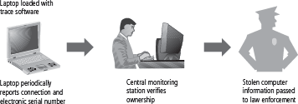
Mobile and Portable Systems
Figure 9-6 Laptop theft deterrence

Slide 17
Remote Computing Security
Remote site computing: away from organizational facility
Telecommuting: computing using telecommunications including Internet, dial-up, or leased point-to-point links
Employees may need to access networks on business trips; telecommuters need access from home systems or satellite offices
To provide secure extension of organization’s internal networks, all external connections and systems must be secured

